Slide 1
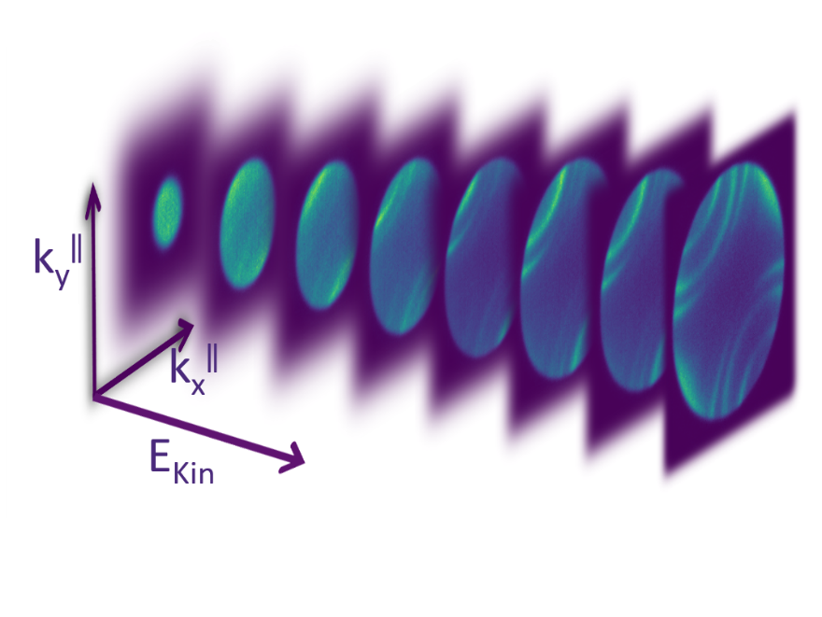
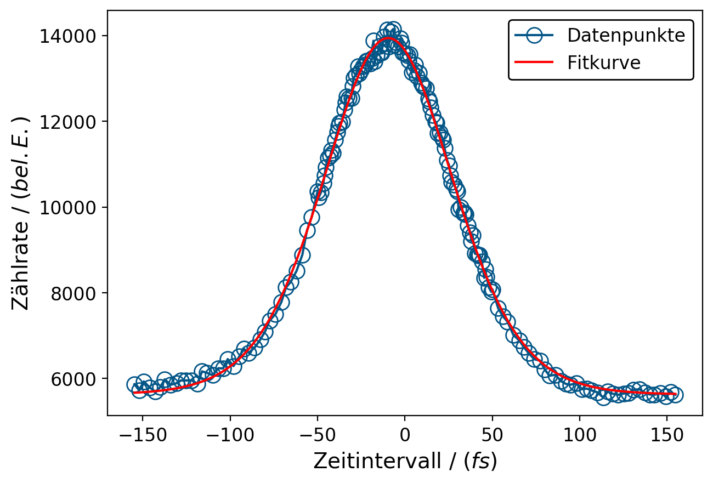

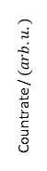
Manual for k-space data evaluation software - using snomtools DataSets and HDF5 data format
23.09.2020 Lukas Hellbrück - Based on time-resolved PEEM data analysis by Tobias Eul Scripts can be run with Python environment
data points
Countrate / $(arb. u.)$
fit curve
delay / $(fs)$

Slide 2
General usage
The scripts are written with momentum resolved data measured with PEEM in mind.
BUT: Changing the import.py function that imports the raw data with snomtools make all scripts usable with other instruments
This manual is supposed to give a short overview over the functions, but you should be able to run the scripts from their documentation
Two example data sets (example_data_set.hdf5 & example_data_set_tr.hdf5) are given and by filling the placeholders with the # example : text the scripts run on these data sets (import_static.py & import_tr.py excluded)
This should give a better introduction on how to use the scripts

Slide 3
Static data
The scripts that can be used for static data analysis are:
import_static.py
rotate.py
binning.py
energy_trans.py
kscale.py
With the following scripts to display & evaluate momentum scaled data:
kspace_map.py
energy_dist_map.py
band_analysis.py
usually executed in this order

Slide 4
Static data: import_static.py
Imports a raw data .tif file with snomtools into a DataSet format and saves it in a .hf5 file.
Only for static data measured with PEEM (Chamber 3).
Input:
Define folder path containing all data
Add folder to energy calibration and corresponding .txt file
Add folder containing the static data
Add name of .tif file containing the raw data
Code snippet:
rawdatafolder = os.path.abspath("Add folderpath") # example: "E:\\Messdaten\\20200117_Au788_Zheng" ecal = os.path.join(rawdatafolder, "ecal_folder", "ecal_kalfit_txt") staticfolder = os.path.join(rawdatafolder, "Add static datafolder") # example "02_kspace" tiffname = "tiff data_name" # example "01_kspace_THG_GI_Texp45m3s.tif" tiff_path = os.path.join(staticfolder, tiffname)
Output:
.hdf5 file with same name as the input .tif file

Slide 5
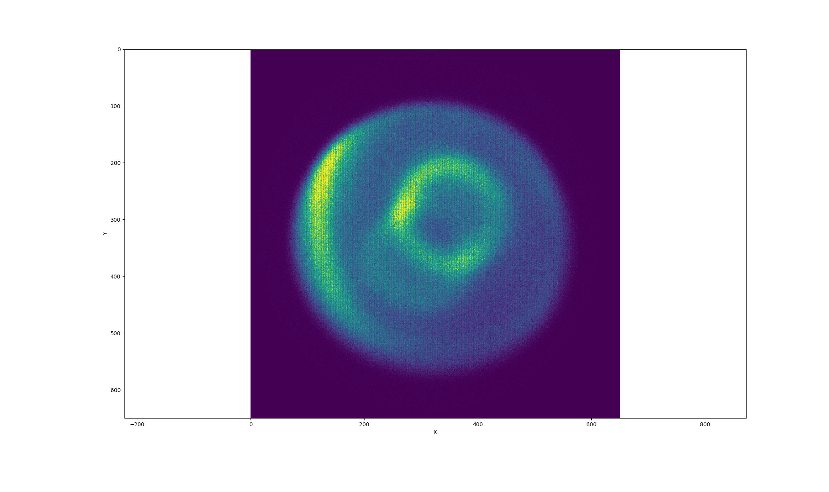
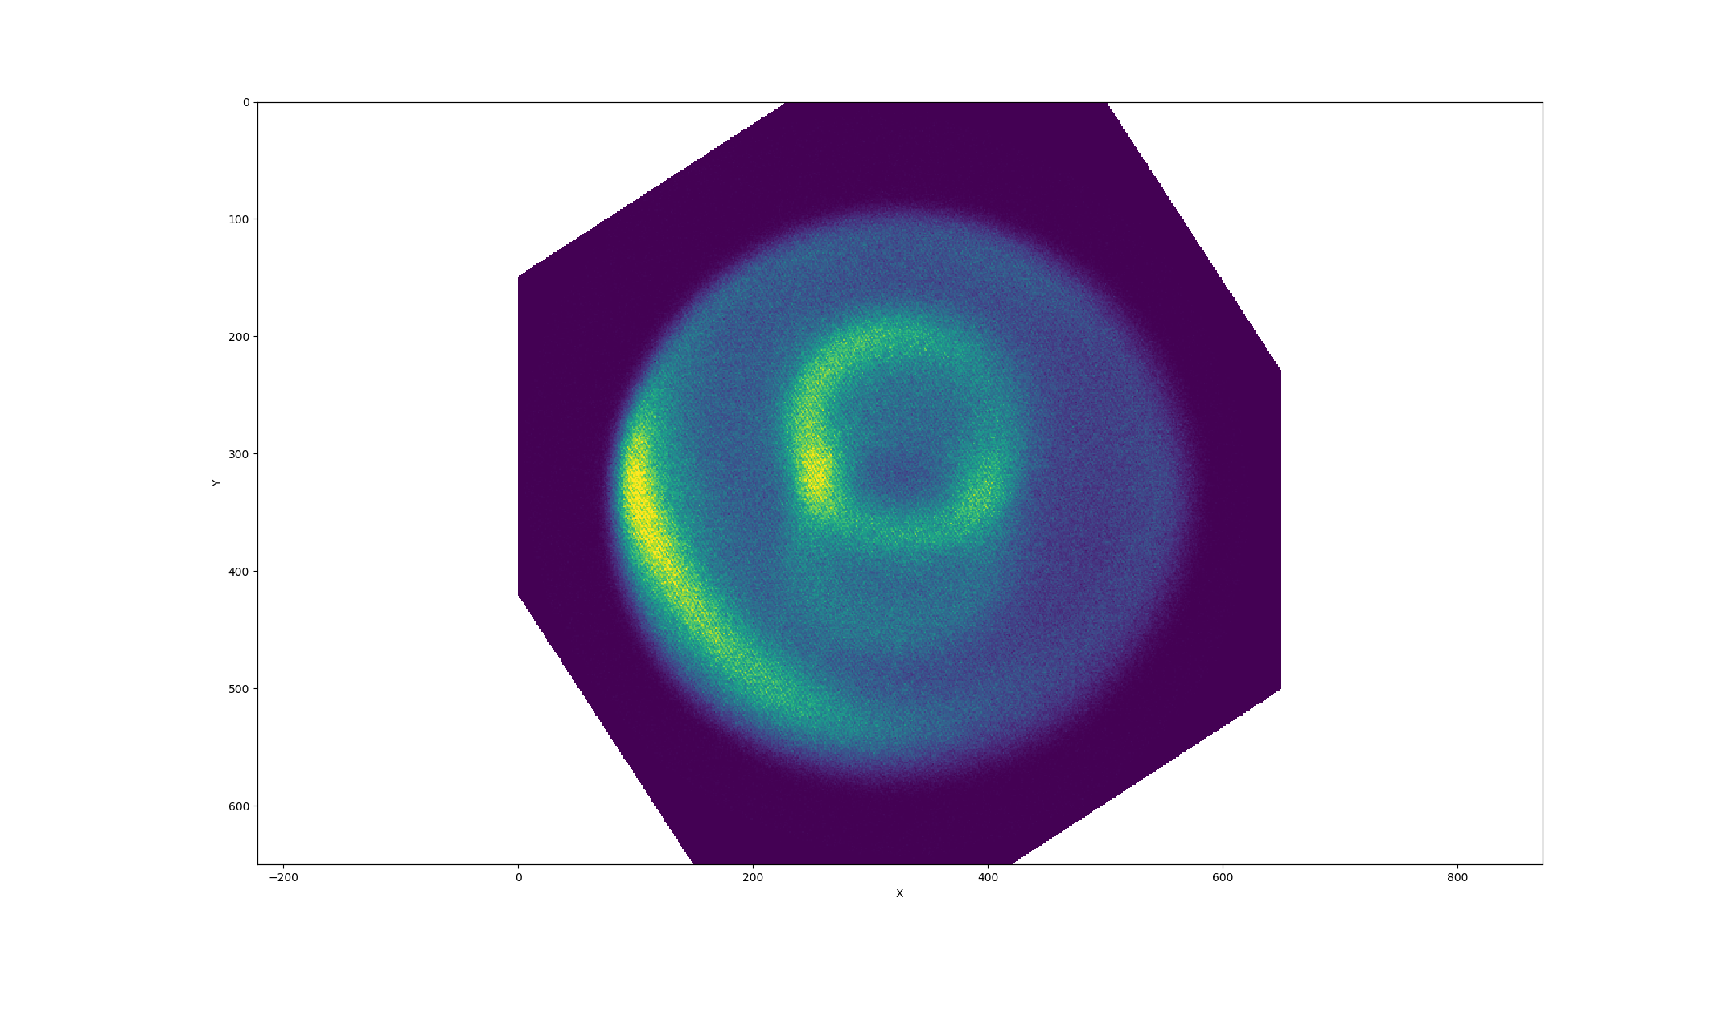
Static data: rotate.py
Rotate a 3D DataSet around the energy axis, to align high symmetry directions with x/y axes.
Input:
With snomtools imported .hdf5 file
file = os.path.abspath("HDF5 file") # example: "example_data_set.hdf5"
Code snippet:
angle = "theta" # example : 45 x_axisid = "x-axis" # example : 'x' y_axisid = "y-axis" # example : 'y'
Define the angle by which to turn the stack
Define the plane which should be rotated usually x/y
Output:
Rotated input DataSet file with ending “theta”deg.hdf5

Slide 6
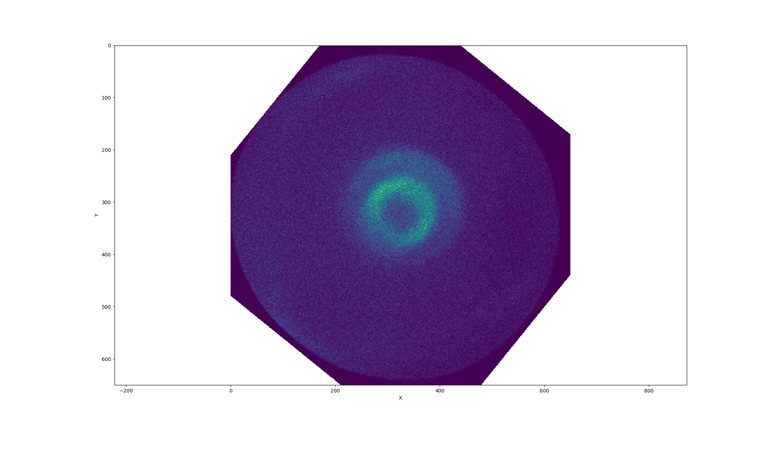
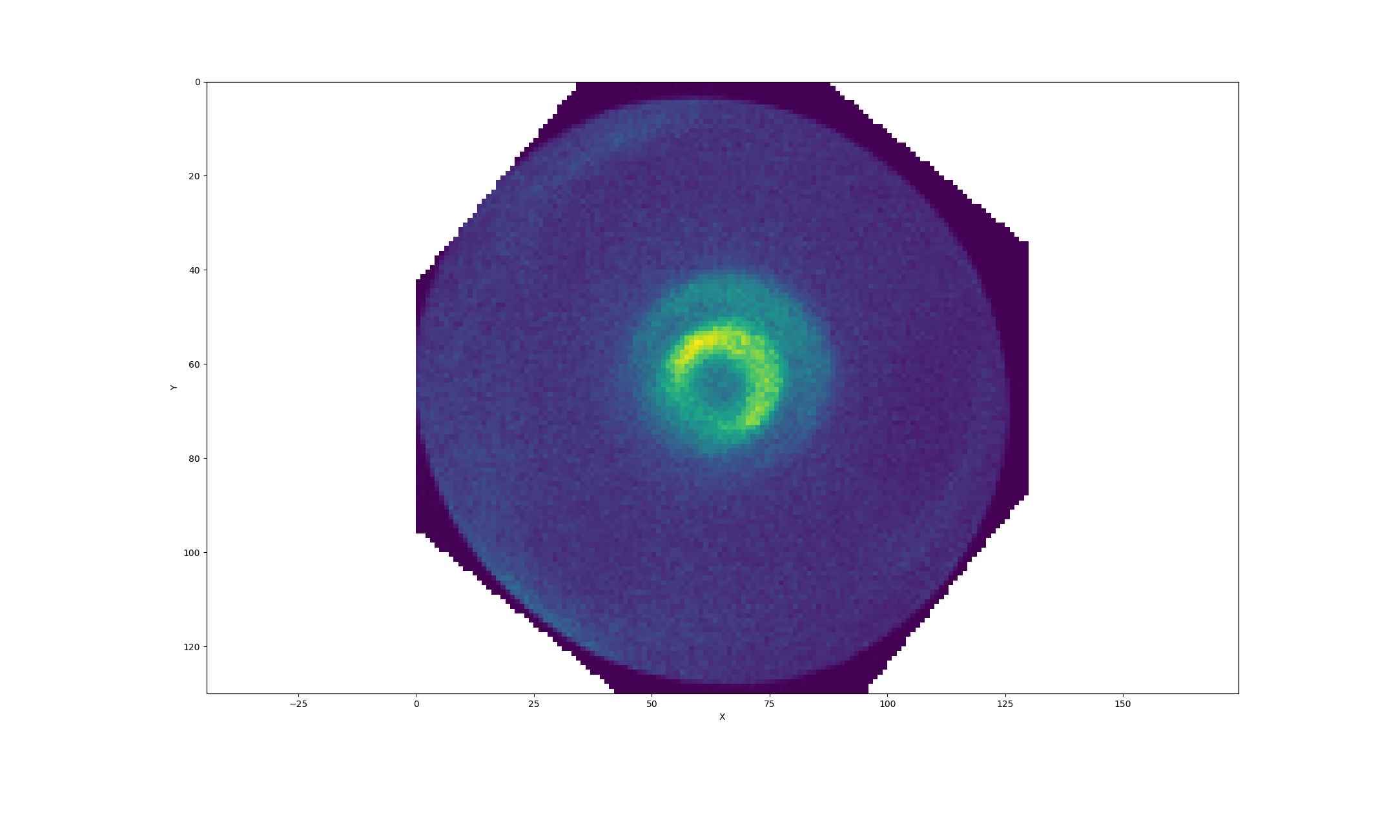
Static data: binning.py
Bin a DataSet for better signal-to-noise ratio.
Input:
With snomtools imported .hdf5 file
data_h5 = os.path.abspath("Data HDF5") # example : "example_data_set.hdf5"
Code snippet:
binned_data = snomtools.data.transformation.binning.Binning(
dataset, binAxisID=('x', 'y', 'energy'), binFactor=(5, 5, 2))
Define the axis along which to bin in binAxisID
Define the binning factor for each axis in binFactor
Output:
Binned input DataSet file with ending _Binned.hdf5

Slide 7
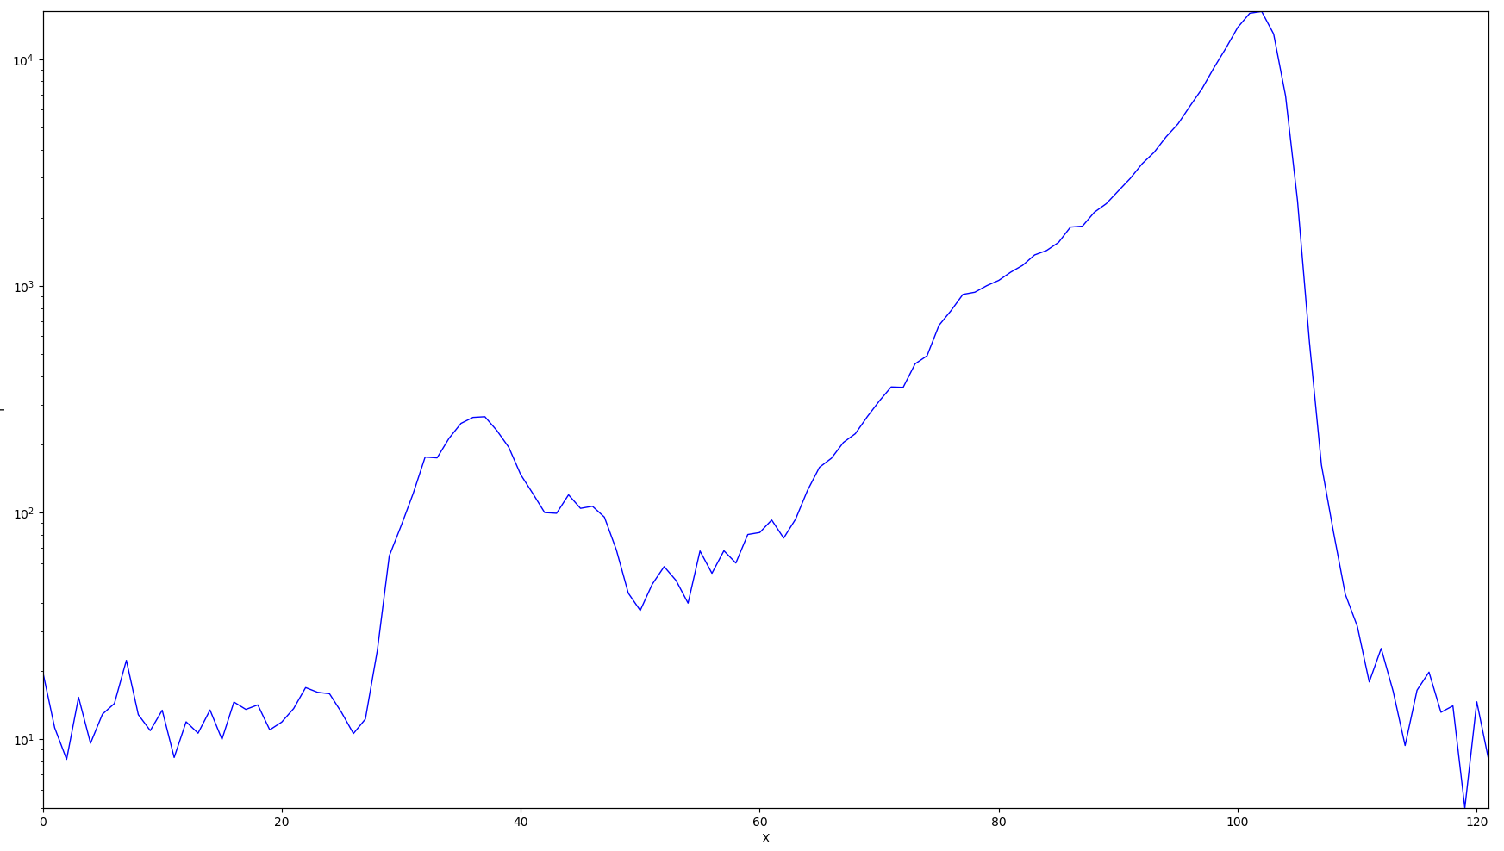
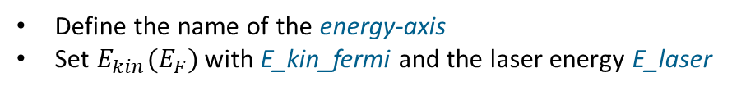
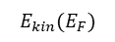
Static data: energy_trans.py
reading out the kinetic energy at fermi edge
like indicated with red dotted line
Transform the energy axis by shifting from measured kinetic energy to
intermediate-/final-/binding-energy.
Input:
With snomtools imported .hdf5 file
file = "HDF5 File" # example : "example_data_set.hdf5"
Code snippet:
energy_id = "energy-axis" # example : 'energy' E_kin_fermi = "kinetic energy at fermi edge" # example : u.to_ureg(34.0798, 'eV') E_laser = "photon energy" # example : u.to_ureg(4.6, 'eV')
$$E_{kin}(E_{F})$$
Define the name of the energy-axis
Set $E_{kin}(E_{F})$ with E_kin_fermi and the laser energy E_laser
# example : u.to_ureg(34.0798, 'eV')
snomtools command for a number with unit
# Choose axis to which you want to scale # example : interm_axis shifted_axis = interm_axis
Chose to which scale you want to shift with
interm_axis/final_axis/binding_axis respectively

Slide 8
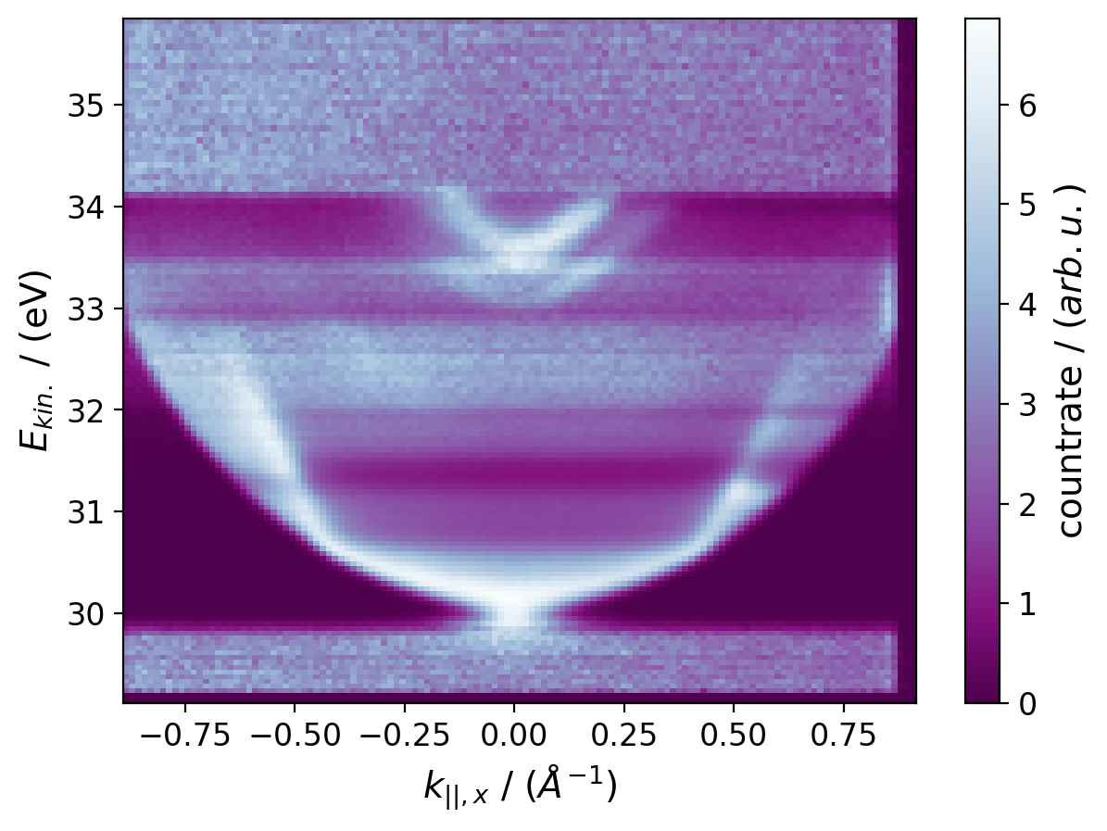
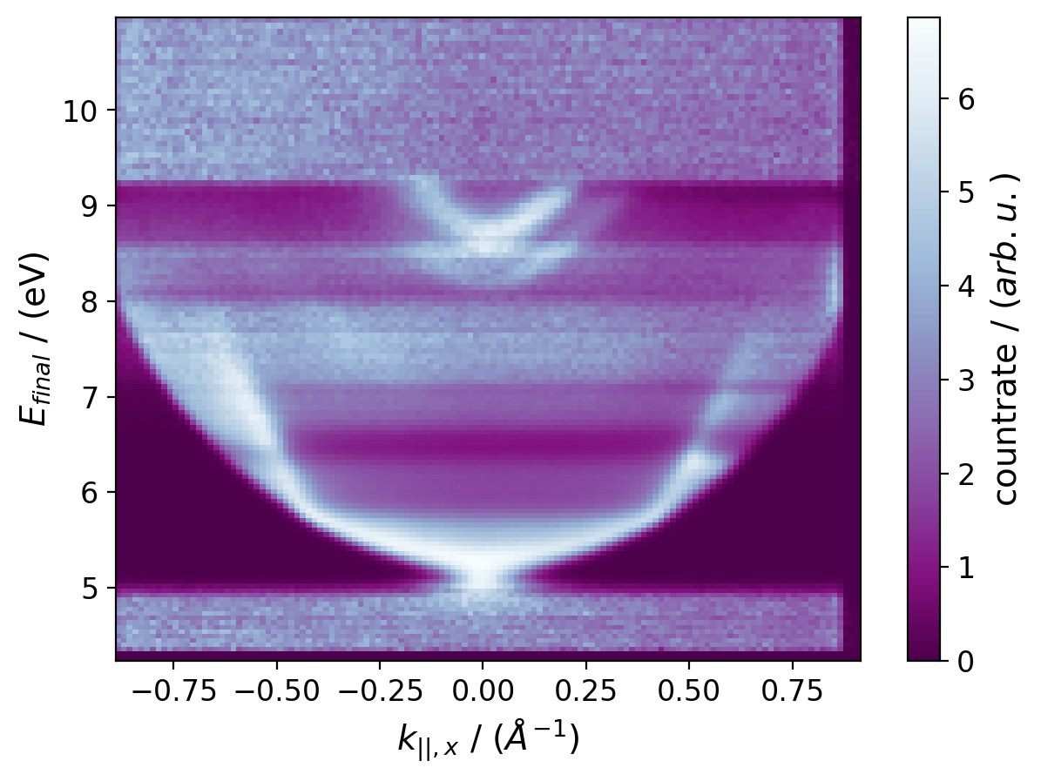
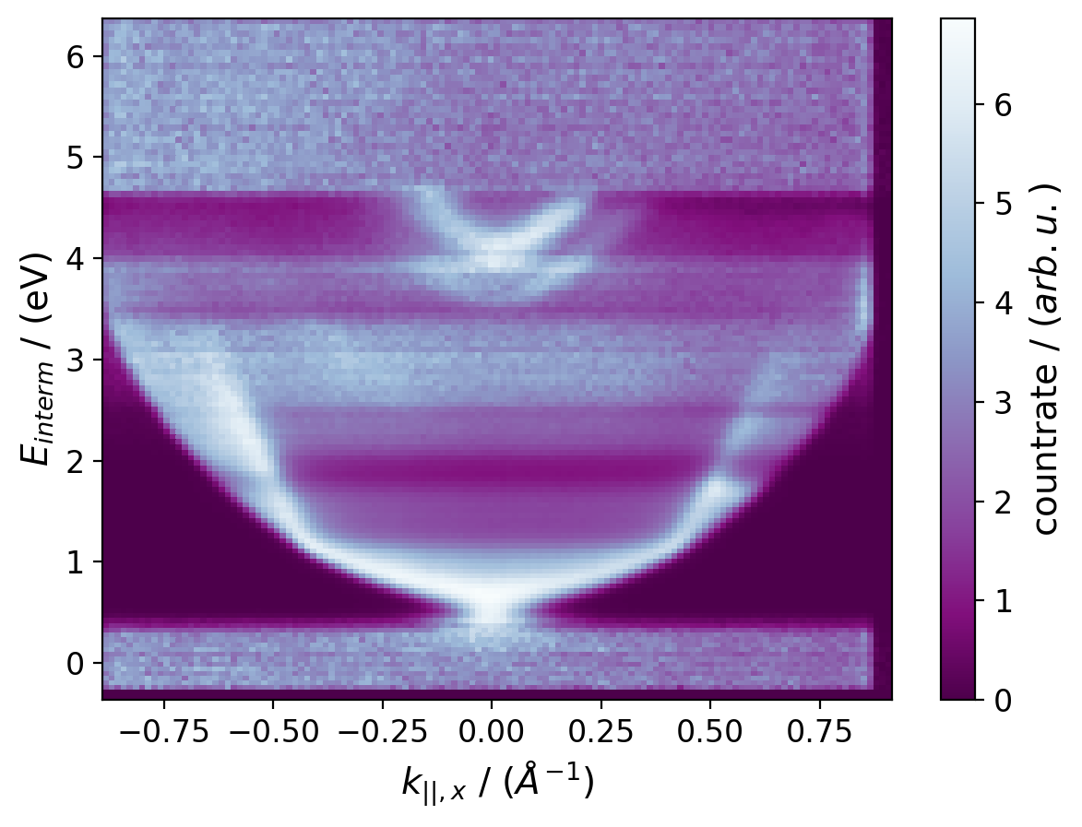
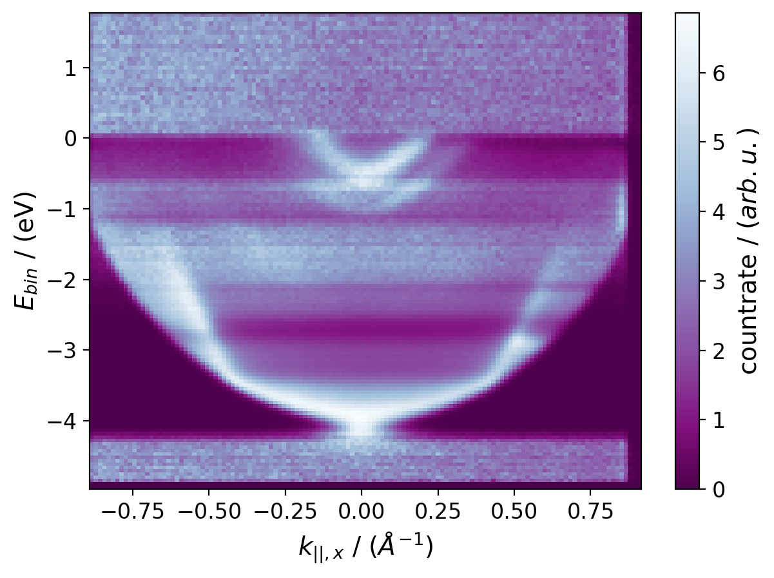
Static data: energy_trans.py
Code snippet:
# Transforming energyscale to Final energy final_axis = full_data.get_axis(energy_id) - E_kin_fermi + 2 * E_laser # Transforming energyscale to Intermediate energy interm_axis = full_data.get_axis(energy_id) - E_kin_fermi + E_laser # Transforming energyscale to Binding energy binding_axis = full_data.get_axis(energy_id) - E_kin_fermi
Formula to scale from kinetic E to respective scale
kinetic energy scale
final state energy scale
intermediate state energy scale
binding energy scale
Output:
Energy shifted input DataSet file with ending e.g.: _Int.hdf5

Slide 9
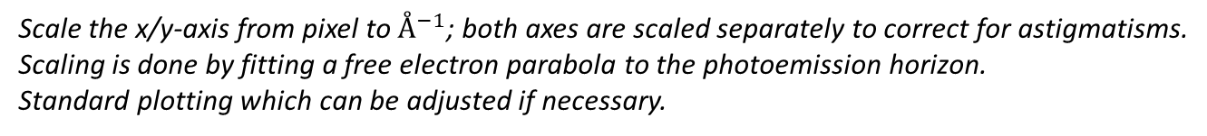
Static data: kscale.py
Scale the x/y-axis from pixel to $Å^{−1}$; both axes are scaled separately to correct for astigmatisms.
Scaling is done by fitting a free electron parabola to the photoemission horizon.
Standard plotting which can be adjusted if necessary.
Input:
With snomtools imported .hdf5 file
file = "HDF5 file to scale" # example : "example_data_set.hdf5"
Code snippet:
x_scalefactor = None # example : u.to_ureg(0.00270, 'angstrom**-1 per pixel') y_scalefactor = None # example : u.to_ureg(0.00275, 'angstrom**-1 per pixel') e_offset = None # example : u.to_ureg(29.9, 'eV') x_zero = None # example : u.to_ureg(320, 'pixel') y_zero = None # example : u.to_ureg(321, 'pixel')
Define the fit parameters for the parabola in x- and y-direction
x_axisid = "x-axis" # example : 'x' y_axisid = "y-axis" # example : 'y' e_axisid = "energy-axis" # example : 'energy'
Set the labels of your DataSet

Slide 10
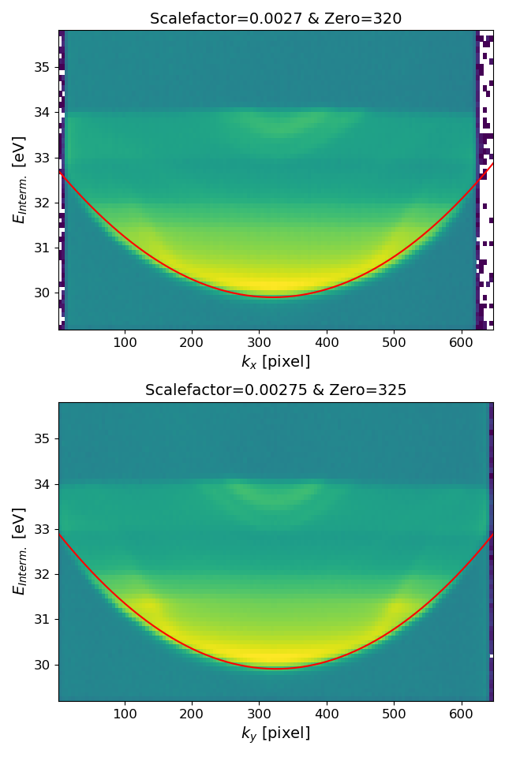
Static data: kscale.py
Code snippet:
save = False x_figname = 'Figure Name k_x' y_figname = 'Figure Name k_y'
Switch for saving the dispersion plot with the given name
x_dispersion_data = snomtools.evaluation.kscalecalibration.load_dispersion_data( full_data, x_axisid, y_axisid, e_axisid, d_axisid=False)
Creates a dispersion plot along one $k_{∥}$ direction
(x_pixels, x_parab_data), x_scalefactor, x_zeropoint = snomtools.evaluation.kscalecalibration.show_kscale(x_dispersion_data, x_zero, x_scalefactor, e_offset, kfov, x_axisid)
Calculates the parabola with above parameters
Returns the parabola data to plot, tuple of (x,y)-values
kscale_axes(full_data, y_scalefactor, x_scalefactor, y_zero, x_zero, y_axisid, x_axisid)
Scales the x and y axis with resp. factors
Output:
Kscaled input DataSet file with ending _Kscaled.hdf5

Slide 11
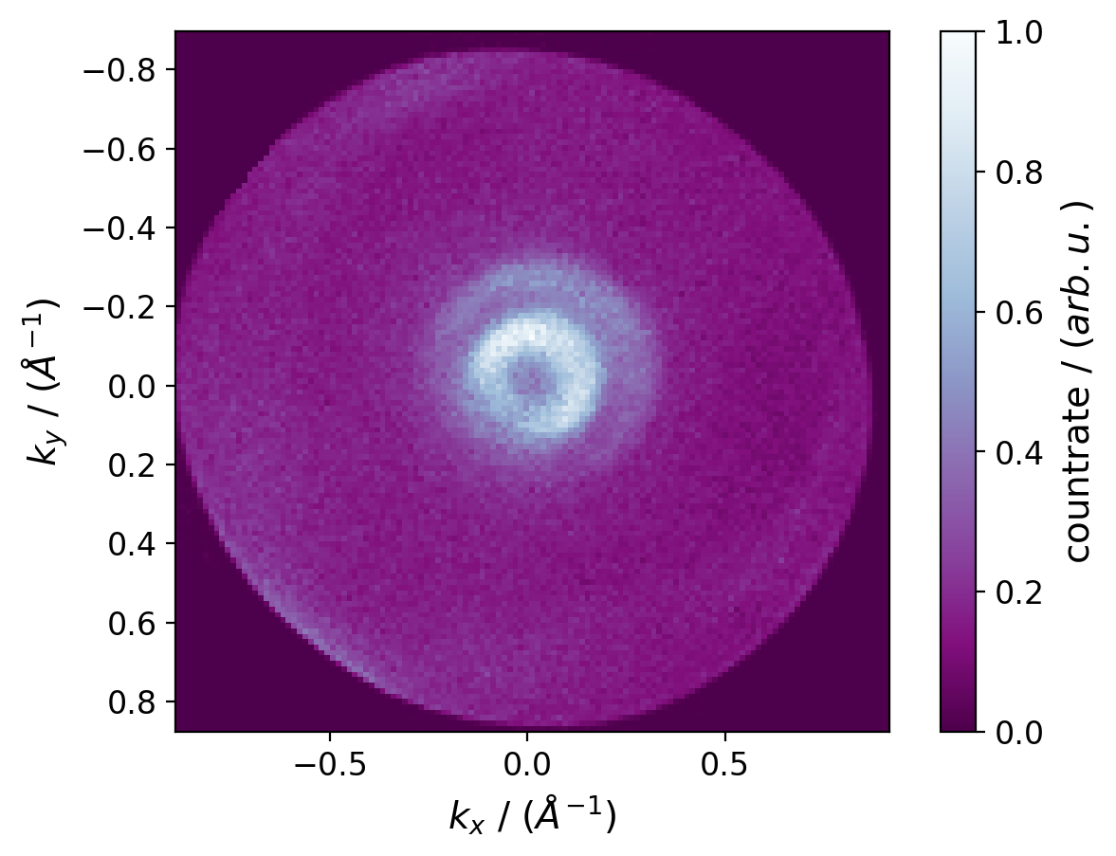
Static data: kspace_map.py
Plot a constant energy map in momentum space from a momentum scaled DataSet.
Usually used with static data but also for time-resolved data with same code.
Input:
With snomtools imported and k scaled .hdf5 file
k_h5 = os.path.abspath("Kscaled HDF5") # example : "example_data_set_Kscaled.hdf5"
Code snippet:
sum_boundaries_index["Energy Axis"] = ["Channel", "Channel"]
# example : ['energy'] = [16,16]
Set name of energy axis
define energy channel by index to display
save = False figname = "k_map_name" # example : 'sample_kspace_map_energy_channel'
Switch for saving the plot in .png with filename figname
Output:
Plot of CE (constant energy) map as a .png file
CE map with standard plot settings as example

Slide 12
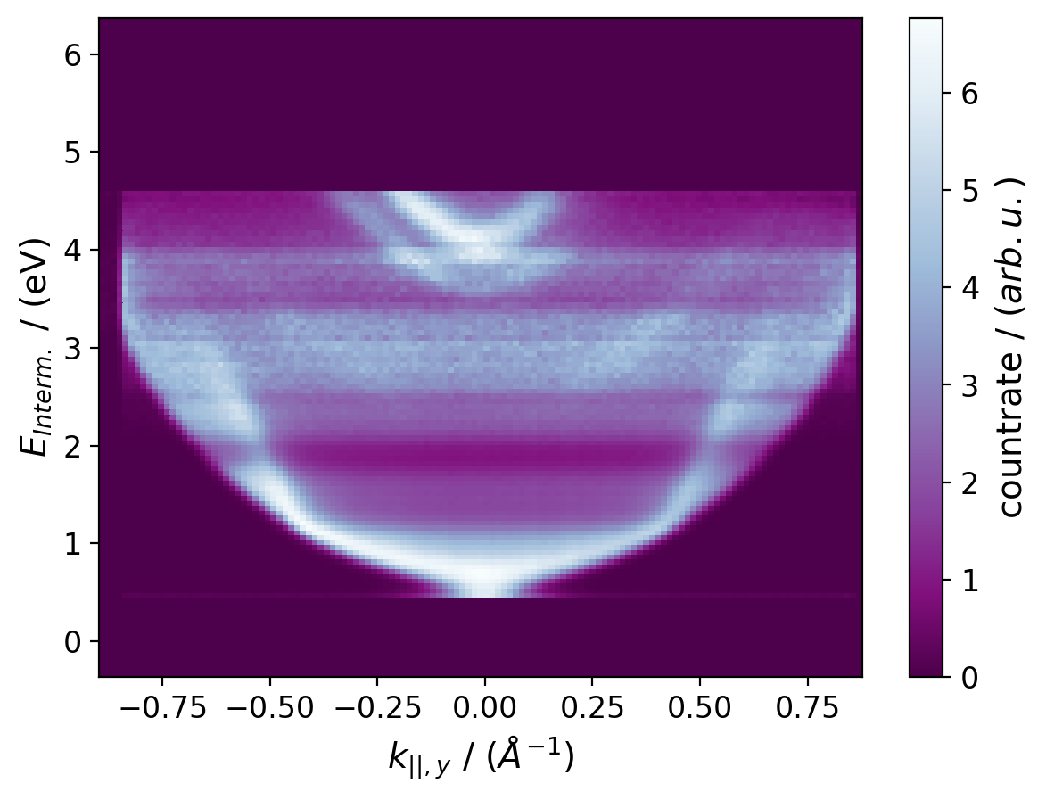
Static data: energy_dist_map.py
Plot a energy distribution map from a momentum scaled DataSet.
Usually used with static data but also for time-resolved data with same code.
Input:
With snomtools imported and k scaled .hdf5 file
k_h5 = os.path.abspath("Kscaled HDF5") # example : "example_data_set_Kscaled.hdf5"
Code snippet:
dispersion_data = snomtools.evaluation.kscalecalibration.load_dispersion_data( data,
y_axisid="k_|| axis", # example : 'k_y' x_axisid="k_|| axis", # example : 'k_x' e_axisid="energy-axis", # example : 'energy' x_window="Amount", # example : 10 d_axisid=False)
EDM with standard plot settings as example
Set name of axes and amount of x pixels to integrate over in x_window
d_axisid=True for also projecting the delay axis for tr data
save = False figname = "Energy Distribution Map" # example : 'sample_edm_k_y'
Switch for saving the plot in .png with filename figname
Output:
Plot of EDM (energy distribution map) as a .png file

Slide 13
Static data: band_analysis.py
Plot a energy distribution map together with a free electron parabola from a k scaled DataSet.
Used to fit and extract parameters for free electron like states.
Standard plotting which can be adjusted if necessary.
Input:
With snomtools imported and k scaled .hdf5 file
k_h5 = os.path.abspath("Kscaled HDF5") # example : "example_data_set_Kscaled.hdf5"
Code snippet:
bandmass = None # example: u.to_ureg(0.28 * c.m_e , 'kg') e_offset = None # example: u.to_ureg(33.5, 'eV') zero = None # example: u.to_ureg(0.01, 'angstrom**-1')
Fit parameter for a free electron parabola with an effective mass bandmass
x_axisid = "k||-axis" # example : 'k_x' y_axisid = "k||-axis" # example : 'k_y' e_axisid = "energy-axis" # example : 'energy'
Set the labels of your DataSet

Slide 14
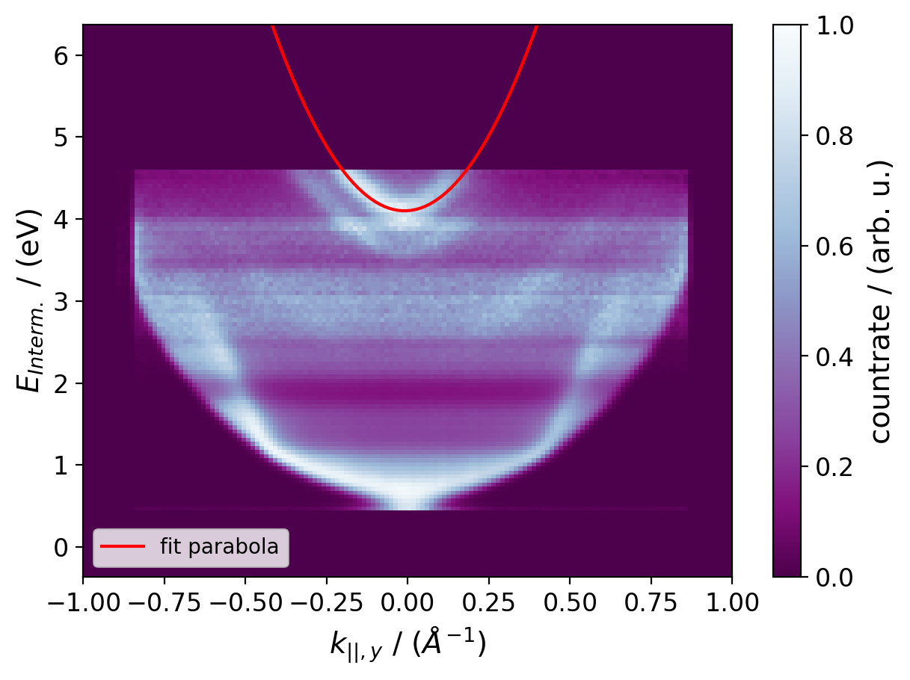
Static data: band_analysis.py
Code snippet:
save = False figname = "Figure Name" # example : 'sample_band_ky'
Switch for saving the plot in .png with filename figname
dispersion_data = snomtools.evaluation.kscalecalibration.load_dispersion_data( data, y_axisid, x_axisid, e_axisid, x_window="Amount", d_axisid=False) # example : x_window=10
Creates a dispersion plot along one $k_{∥}$ direction
EDM with a parabola fitted to the
occupied part of the surface state with
(k_parallel, parab_data), bandmass =
snomtools.evaluation.kscalecalibration.show_state_parabola( dispersion_data, figname, zero, bandmass, e_offset, y_axisid)
bandmass = u.to_ureg(0.28 * m_e , 'kg') e_offset = u.to_ureg(4.1, 'eV') zero = u.to_ureg(0, 'pixel')
Calculates the parabola with above parameters
Returns the parabola data to plot, tuple of (x,y)-values
Output:
Plot of a EDM together with an adjusted free electron parabola as a .png file

Slide 15
Time-resolved data
Except import.py the same functions as static case can be applied with additional scripts specifically for time-resolved data:
The scripts that can be used for time-resolved data analysis are:
import_tr.py
summing.py
binning.py
energy_trans.py
kscale.py
fit_fwhm.py
cuda_eval.py
usually executed in this order

Slide 16
Time-resolved data: import_tr.py
Imports a raw data .tif file with snomtools into a DataSet format and saves it in a .hf5 file.
Only for static data measured with PEEM (Chamber 3).
Input:
Define folder path containing all data
Add folder to energy calibration and corresponding .txt file
Add folder containing all time resolved runs
rawdatafolder = os.path.abspath("Add folderpath") # example : "E:\\Messdaten\\20200117_Au788_Zheng" ecal = os.path.join(rawdatafolder, "ecal_folder", "ecal_kalfit_txt") trfolder = os.path.join(rawdatafolder, "Add tr_datafolder")
Code snippet:
runs = ["{0}. Durchlauf".format(n) for n in range(x, y)] # example : range(1, 3)
Define the runs you want to import e.g. with range(1, 3) or with lists etc.
Output:
.hdf5 file with same name as the input .tif file

Slide 17
Time-resolved data: summing.py
Sums up multiple runs that were already imported to DataSets with snomtools.
Input:
Define the runs you want to sum up e.g. with range(1, 3) or lists etc.
runs = ["{0}. Durchlauf.hdf5".format(n) for n in range(1, 3)]
Code snippet:
h5_target_all_runs = "Destination" # example "runs1_2" summed_data = ds.DataSet.add(run_datasets, "Destination", h5target=h5_target_all_runs)
Set the name of new combined DataSet in “Destination”
Output:
.hdf5 file with new “Destination” name as the .hdf5 file

Slide 18
Time-resolved data: binning.py
energy_trans.py
kscale.py
The static functions can be used for time resolved data as well.
Usually there is an option to also bin or improve signal to noise by sum over the time dimension.
This option is not often used, but it’s a possibility.
Code snippet:
x_dispersion_data = snomtools.evaluation.kscalecalibration.load_dispersion_data(full_data, x_axisid, y_axisid, e_axisid, d_axisid=False)
To use this option it’s usually done by setting d_axisid to the label in your data set
With the parameters in the functions d_window and d_center it’s possible to do the same summation as for the x axis

Slide 19
Time-resolved data: fit_fwhm.py
The script provides the possibility of fitting a Gaussian, Lorentzian or Sech2 curve to the data.
The fit parameters for the FWHM and for recreating the fitted curve are exported and saved.
Input:
With snomtools imported .hdf5 file
fith5 = os.path.abspath("TR Data HDF5") # example : "example_data_set_tr.hdf5"
Code snippet:
fit_type = "fit mode" # example: 'gaussian'
Set the fit_type to the curve you want to fit to your data.
Possible are ‘gaussian’ / ‘lorentzian’ / ‘sech2’
Output:
.hdf5 file containing the fitting parameters with _’fitmode’.hdf5 ending

Slide 20
Time-resolved data: cuda_eval.py
The script provides the possibility of fitting LvN equations to a time resolved DataSet.
Since it needs a lot of resources to run the simulation, you should run it with nvidia cuda on the elwe.
For that install snomtools and pint on elwe and run the script on there.
The script simulates the lifetimes for ONE energy slice.
Input:
With snomtools imported .hdf5 file
# Recommended folder structure : /home/username/repos/evaluation/year/month/datafolder home = os.path.expanduser("~") sys.path.insert(0, os.path.join(home, "repos/snomtools/src/")) # Example for an additional dependency from source: sys.path.insert(0, os.path.join(home, "repos/pint/")) wd = "path to datafolder" # example : "/home/username/repos/evaluation/2020/01 January/20200128_Au788_Zheng_blue"
Set the path to folder with the time resolved DataSet
It is expected that you create a repos folder in your username folder on elwe2
install snomtools and pint, as well as the evaluation scripts in repos

Slide 21
Time-resolved data: cuda_eval.py
Code snippet:
time_zero = "time zero value" # example : u.to_ureg(3, 'um').to('fs', 'light') laser_fwhm = "laser FWHM value" # example : u.to_ureg(25, 'um').to('fs', 'light')
Set the time zero of the time resolved data
Shifts delay_axis so that time_zero is actually 0fs for the cuda simulation
Set the laser_fwhm which can be read out from the fwhm fitted DataSet
Use the fwhm of a pixel with a high energy and off a state
obeobject = snomtools.evaluation.cuda.obe_copol.OBEfit_Copol(roi_to_fit, laser_lambda=u.to_ureg(400, 'nm'), laser_AC_FWHM=laser_fwhm, time_zero=u.to_ureg(0, 'fs'), max_time_zero_offset=u.to_ureg(40, 'fs'), max_lifetime=u.to_ureg(50,'fs'), fit_mode='gauss')
Set the fit parameters according to your measurement
time_zero should be 0fs since the delay axis is shifted above!

Slide 22
Time-resolved data: cuda_eval.py
Code snippet:
oberesults.saveh5(infile.replace('.hdf5', '') + "_lifetimes_eslice{0}.hdf5".format(roi)) obefits.saveh5(infile.replace('.hdf5', '') + "_lifetimes_eslice{0}_fitdata.hdf5".format(roi))
DataSet with lifetimes is saved
fit paramters are saved in a separate file to reproduce and plot fits later on
#!/bin/bash #SBATCH --ntasks=1 #SBATCH -C XEON_E5_2670 #SBATCH --gres=gpu:K20Xm:1 python3 /home/hellbrue/repos/evaluation/2020/01\ January/20200128_Au788_Zheng_blue/cuda_eval.py -v -roi16
Start the script by submitting cuda_eval_job through the batch system on elwe2
First 4 lines are for addressing the graphic node (can change over time)
Last line add the address to the cuda_eval.py
Define the energy slice you want to evaluate with –roi”energychannel”
Output:
.hdf5 file containing the lifetimes with _lifetime_eslice.hdf5 ending
.hdf5 file containing the fitting parameters with _lifetime_eslice_fitdata.hdf5 ending

Slide 23
Time-resolved data
With the following scripts to display & evaluate momentum scaled data:
kspace_map.py
energy_dist_map.py
band_analysis.py
plot_fwhm_fits.py
plot_obe_fits.py
lifetime_map.py
Same functions as static case usually used with static data, cause of higher integration times
Specific functions only for time-resolved data

Slide 24
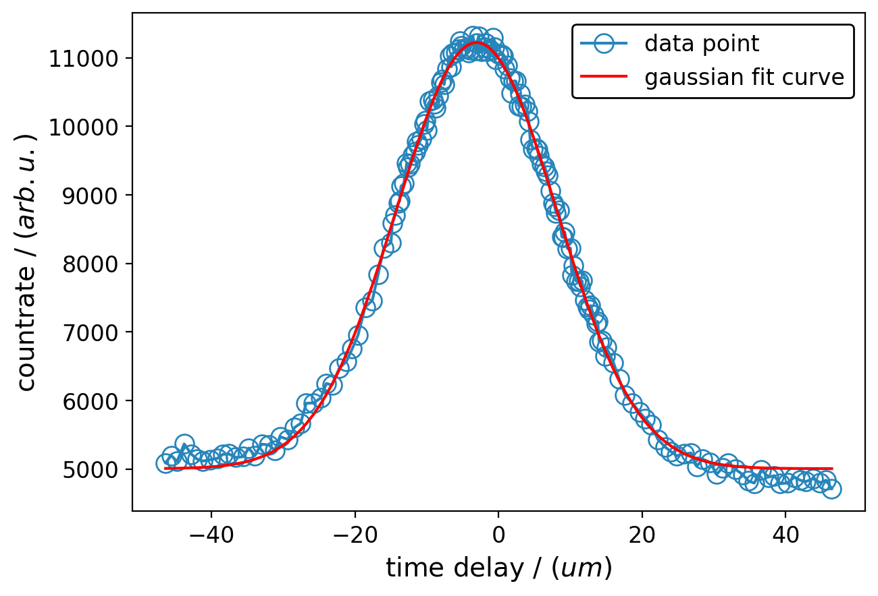
Time-resolved data: plot_fwhm_fits.py
Plot the calculated fits from fit_fwhm.py together with the measured data.
Used to check the quality of the fit.
Has a standard way for plotting which can be adjusted if necessary.
Input:
With snomtools imported .hdf5 file and fitted DataSet from cuda_eval.py
fith5 = os.path.abspath(“Fitted HDF5") # example : "example_data_set_tr_Gaussfit.hdf5" binnedh5 = os.path.abspath("Data HDF5") # example : "example_data_set_tr.hdf5"
Code snippet:
energy = "energy channel" # example : 16 x = "x-Pixel" # example: 33 y = "y-Pixel" # example : 34
Address the pixel/data point you want to display the fit for
mode = "Fit Mode"
Set mode to the fit curve used in fit_fwhm.py
Possible are ‘gaussian’ / ‘lorentzian’ / ‘sech2’
save = False figname = "sample_FWHMfit_energy_pixel"
Trigger for saving plot with the figname
Example for Gauss fitted data set
Output:
Plot of fit curve together with measured data points as a .png file

Slide 25
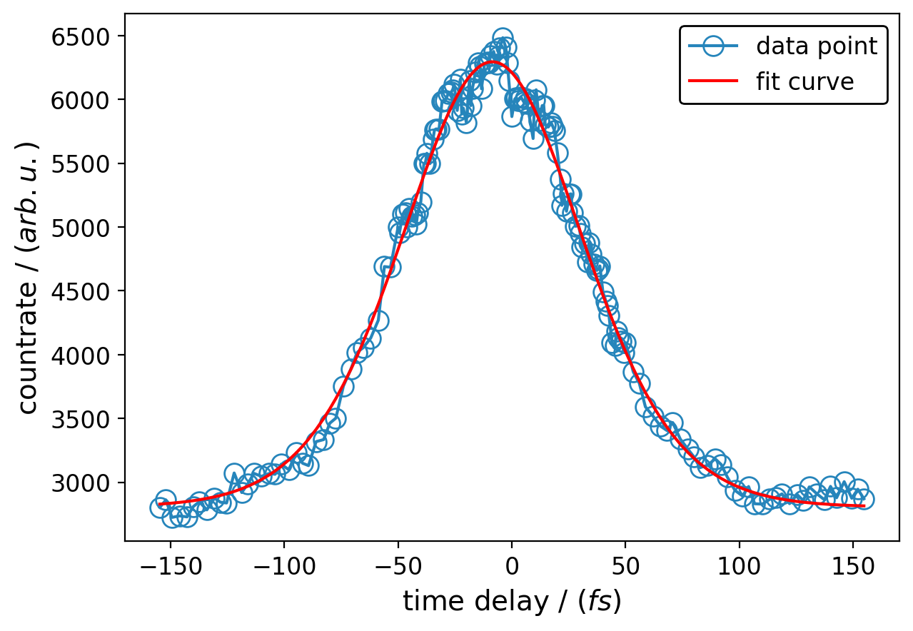
Time-resolved data: plot_obe_fits.py
Plot the calculated lifetime fits from cuda_eval.py together with the measured data.
Used to check the quality of the fit.
Has a standard way for plotting which can be adjusted if necessary.
Input:
With snomtools imported .hdf5 file and file containing fit parameters from cuda_eval.py
fith5 = os.path.abspath("fitparameter HDF5 file") binnedh5 = os.path.abspath("Data HDF5")
Code snippet:
time_zero_um = u.to_ureg("Time Zero", 'um') # example : 3
Set the time_zero in um from your data set
energy = "energy channel" # example : 16 x = "x-Pixel" # example: 33 y = "y-Pixel" # example : 34
Address the pixel/data point you want to display the fit for
save = False figname = "sample_ACfit_energy_pixel"
Trigger for saving plot with the figname
Example for lifetime fitted DataSet
Output:
Plot of lifetime fit curve together with measured data points as a .png file

Slide 26
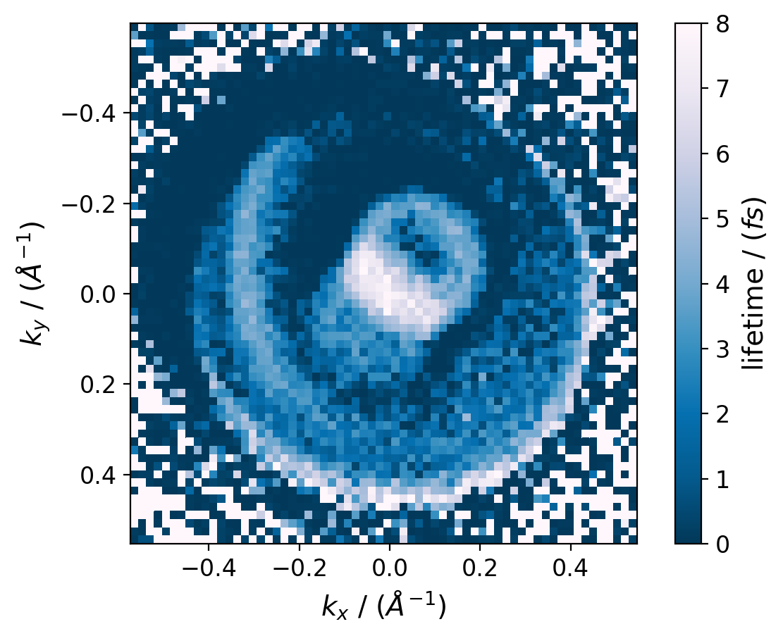
Time-resolved data: lifetime_map.py
Plot a constant energy lifetime map in momentum space from a momentum scaled DataSet.
Used with a time-resolved DataSet with simulated lifetimes from cuda_eval.py.
Input:
With cuda_eval.py simulated .hdf5 file containing the lifetimes of one energy slice
tr_h5 = os.path.abspath(“Lifetime HDF5") # example : "1. Durchlauf_e4_binned_int_kscaled_lifetimes_eslice17.hdf5"
Code snippet:
sum_boundaries_index["Energy Axis"] = [0, 0] # example : 'energy binned x4'
Set name of energy axis; energy channel should be [0, 0] since DataSet only contains one energy slice
save = False figname = "lifetime_map_name" # example : 'sample_lifetime_map_energy_channel'
Switch for saving the plot in .png with filename figname
Output:
Plot of lifetime map as a .png file
lifetime map with standard plot settings as example

